Slide 1

Anurag Srivastava
September 3, 2024

Slide 2

Outline
Executive Summary (Page 3)
Introduction (Page 4)
Methodology (Page 5)
Results (Page16)
EDA With Visualization (Page 18)
EDA with SQL (Page 24)
Interactive Maps with Folium (Page 34)
Plotly Dash Dashboard (Page 38)
Predictive Analytics (Page 43)
Conclusion (Page 46)
Appendix (Page 47)

Slide 3
Executive Summary
The project involved a comprehensive approach to predictive modeling aimed at forecasting the success of SpaceX Falcon 9 first stage landings. Various machine learning techniques were applied, including data collection, data wrangling, and exploratory data analysis. Data was gathered through RESTful APIs and web scraping, followed by in-depth analysis using Python libraries. Interactive maps were developed using Folium to analyze SpaceX launch records and geographical factors influencing launch success. The project also included the creation of interactive dashboards with Plotly Dash, enabling dynamic visualization of the data. The models were rigorously tested, validated, and fine-tuned through hyperparameter optimization to maximize prediction accuracy.
In the results, it is observed that the geographical locations for certain launch sites are favorable due to their proximity to railways, highways, and coastlines. Additionally, launches aimed at specific orbits, such as ES-L1, GEO, HEO, and SSO, have a higher success rate. Moreover, it was noted that the success of launches improves over time. The most accurate model achieved an 83% accuracy rate in predicting the Falcon 9 landing success. These insights provide valuable data for optimizing SpaceX's launch operations, potentially reducing costs and improving efficiency.

Slide 4
Introduction
As a data scientist at Space Y, a new rocket company aiming to compete with SpaceX, our mission is to analyze and predict the outcomes of rocket launches, specifically focusing on the Falcon 9 first stage landing success. SpaceX's ability to reuse the first stage of its rockets is a significant cost-saving advantage, allowing it to offer launch services at a fraction of the cost of its competitors. Understanding and predicting whether the Falcon 9 first stage will successfully land is crucial in estimating launch costs and formulating competitive strategies in the commercial space industry.
Key Questions to Address:
1. Can we accurately predict the likelihood of a Falcon 9 first stage landing success?
- The goal is to develop a machine learning model that predicts whether the first stage will land
successfully, using publicly available data and historical launch records.
2. How can these predictions be used to optimize launch costs and improve competitive positioning?
- By determining the likelihood of a successful landing, Space Y can better estimate the costs of launches
and make informed decisions to compete effectively with SpaceX.

Slide 5

Section 1

Slide 6
Methodology
Executive Summary
Data collection methodology:
Describes how data sets were collected
Perform data wrangling
Describes how data was processed
Perform exploratory data analysis (EDA) using visualization and SQL
Perform interactive visual analytics using Folium and Plotly Dash
Perform predictive analysis using classification models
How to build, tune, evaluate classification models

Slide 7
Data Collection
Using SpaceX REST API
Collected SpaceX launch data using GET requests with helper functions.
Parsed JSON response and converted it into a pandas dataframe
Using Web Scrapping
Web scrapped Falcon-9 historical launch records from a Wikipedia page using BeautifulSoup and Request library
Parsed the HTML table and converted it into a pandas dataframe

Slide 8
Data Collection – SpaceX API
Define Auxiliary Function
to extract information using identification numbers in the launch data.
Make GET Requests to SpaceX API
Request rocket Launch data
Extracted via Auxiliary Function
Decode JSON response
Receive JSON response and Parse JSON data
Convert to Pandas dataframe
Here is the GitHub URL of the SpaceX API calls notebook- https://github.com/Anurag561-tech/Predictive-Modeling-for-Falcon-9-First-Stage-Landing-Success-/blob/main/(1)%20jupyter-labs-spacex-data-collection-api.ipynb

Slide 9

Data Collection - Scraping
Performed an HTTP GET method to request the Falcon9 Launch HTML page
Created a BeautifulSoup object from the HTML response
Extracted all column/variable names from the HTML table header
Created a data frame by parsing the launch HTML tables
Here is the GitHub URL of the web scrapping notebook - https://github.com/Anurag561-tech/Predictive-Modeling-for-Falcon-9-First-Stage-Landing-Success-/blob/main/(2)%20jupyter-labs-webscraping.ipynb

Slide 10
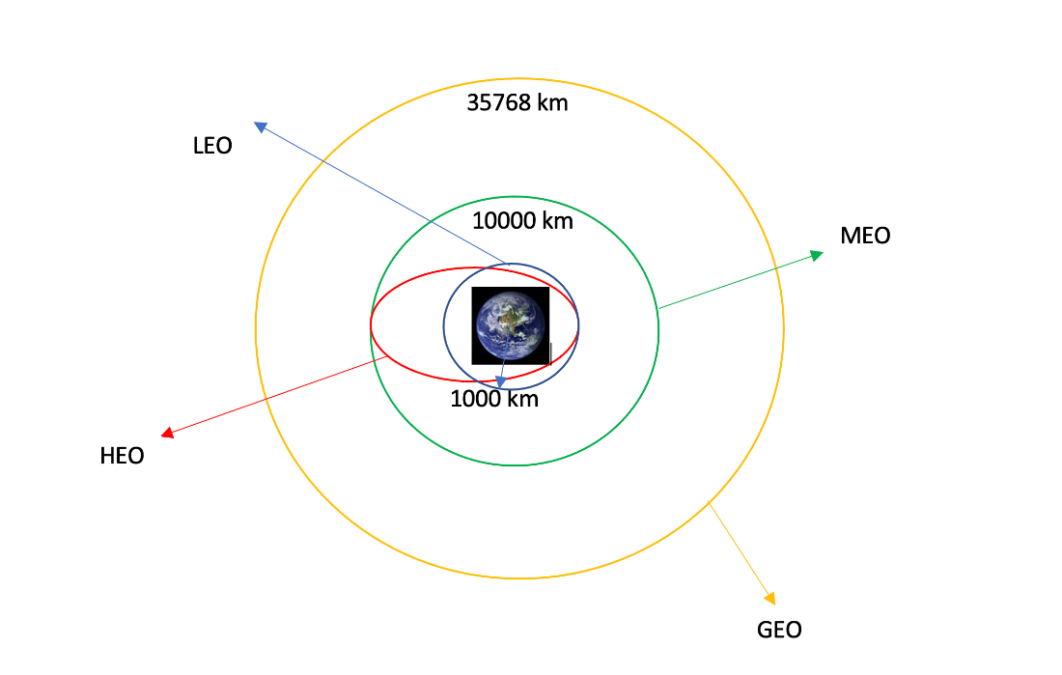
Data Wrangling
Missing data of Payload Mass column replaced with mean of column
Calculating the number of launches per site
Calculating the number and occurrence of each orbit
Calculating the number and occurrences of mission outcomes per orbit
Creating landing outcome labels from the Outcome column
some common orbit types
Here is the GitHub URL of the Data Wrangling notebook - https://github.com/Anurag561-tech/Predictive-Modeling-for-Falcon-9-First-Stage-Landing-Success-/blob/main/(3)%20labs-jupyter-spacex-Data%20wrangling.ipynb

Slide 11

EDA with Data Visualization
Used scatter chart to study relationship between various features like Flight Number, Launch Site, Payload Mass (kg) and Orbit Type
Used bar chart to understand relationship between success rate and orbit type.
Used line chart to visualize the launch success yearly trend.
Here is the GITHUB URL of the complete EDA with data visualization notebook - https://github.com/Anurag561-tech/Predictive-Modeling-for-Falcon-9-First-Stage-Landing-Success-/blob/main/(4)%20edadataviz.ipynb

Slide 12
EDA with SQL
The following SQL queries were performed:
Display names of unique launch sites and 5 records where launch site begins with 'CCA’.
Calculate the total and average payload mass carried by boosters, specifically for NASA (CRS) launches and booster version F9 v1.1.
List the date of the first successful landing on the ground pad and names of boosters with successful landings on drone ships carrying payloads between 4,000 and 6,000.
Provide total counts of successful and failed missions, names of booster versions with max payload, failed landing outcomes on drone ships in 2015, and counts of landing outcomes between 2010-06-04 and 2017-03-20 (descending).
Here is the GITHUB URL of the complete EDA with SQL notebook - https://github.com/Anurag561-tech/Predictive-Modeling-for-Falcon-9-First-Stage-Landing-Success-/blob/main/(5)%20jupyter-labs-eda-sql-coursera_sqllite.ipynb

Slide 13
Build an Interactive Map with Folium
The following Map objects were created and added to a folium map:
Added markers for the closest coastline point and distances to the closest city, railway, highway, etc.
Used ‘folium.Circle’ to highlight launch sites with text labels.
Implemented MousePosition to display coordinates when hovering over the map
Used ‘folium.PolyLine’ to connect launch sites to coastlines, cities, railways, and highways to show distances.
These objects were added to the map to clearly visualize key geographical points and distances. Markers and circles highlight important locations like launch sites, coastlines, cities, railways, and highways. The MousePosition feature helps users easily find coordinates of points on the map, while polylines show distances between launch sites and other significant locations, aiding in spatial analysis.
Here is the GITHUB URL of the complete ‘Interactive map with Folium map’ Notebook - https://github.com/Anurag561-tech/Predictive-Modeling-for-Falcon-9-First-Stage-Landing-Success-/blob/main/(6)%20lab_jupyter_launch_site_location.ipynb

Slide 14
Build a Dashboard with Plotly Dash
In the dashboard following elements were added –
Launch Site Drop-down Input: Added a drop-down component allowing users to select a specific launch site.
Success Pie Chart: Implemented a pie chart that visualizes the success rate of launches based on the selected launch site from the drop-down.
Payload Range Slider: Added a range slider for selecting the payload mass range, allowing dynamic filtering of data.
Success-Payload Scatter Plot: Added a scatter plot that displays the relationship between payload mass and launch success, filtered by the selected launch site and payload range.
The dashboard allows users to filter launch data by site and payload through interactive elements like a drop-down and a range slider. Visuals such as pie charts and scatter plots provide insights into launch success rates and the impact of payload mass on outcomes
Here is the GITHUB URL of the complete ‘Dashboard’ python file- https://github.com/Anurag561-tech/Predictive-Modeling-for-Falcon-9-First-Stage-Landing-Success-/blob/main/(7)%20Build%20an%20Interactive%20Dashboard%20with%20Ploty%20Dash%20-%20spacex_dash_app.py

Slide 15
.
Predictive Analysis (Classification)
Create features and class
Convert the ‘Class’ column to NumPy array (Y)
Standardize the features(X)
Logistic Regression
Create logistic regression model
Perform GridSearchCV for hyperparameter tuning
Support Vector Machine(SVM)
Create SVM model
Perform GridSearchCV for hyperparameter tuning
Split data using train-test split
Calculate test accuracy
Calculate test accuracy
Decision Tree Classifier
Create a decision tree model
Perform GridSearchCV for hyperparameter tuning
Calculate test accuracy
K-Nearest Neighbour(KNN)
Create a KNN model
Perform GridSearchCV for hyperparameter tuning
Calculate test accuracy
Compare Models
Identify the model with the best accuracy
To build the classification model, we standardized the data through preprocessing and split it into training and testing sets using train-test split method. Several models, including Logistic Regression, Support Vector Machines, Decision Tree Classifier, and K-Nearest Neighbors, were trained and evaluated. Grid Search was used to optimize hyperparameters, improving model performance. The best model was selected based on accuracy using the training data, and performance was further evaluated through a confusion matrix.
Here is the GITHUB URL of the complete predictive analysis lab- https://github.com/Anurag561-tech/Predictive-Modeling-for-Falcon-9-First-Stage-Landing-Success-/blob/main/(8)%20SpaceX_Machine%20Learning%20Prediction.ipynb

Slide 16

Results
We will review the following results in the report:
Exploratory data analysis results
Interactive analytics demo in screenshots
Predictive analysis results

Slide 17

Section 2

Slide 18
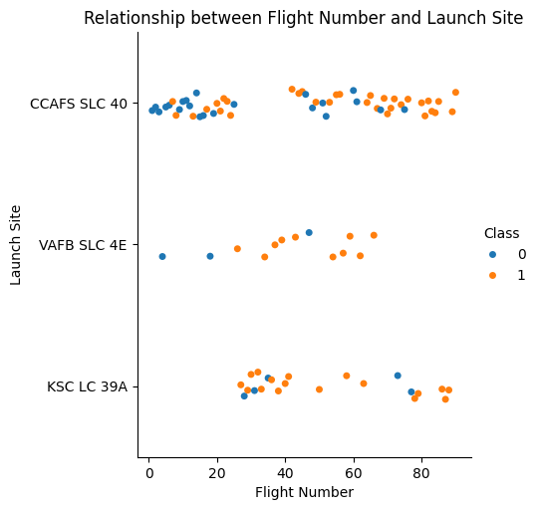
Flight Number vs. Launch Site
From the scatter plot it is visible that as the flight number for each launch site increases success rate increases

Slide 19
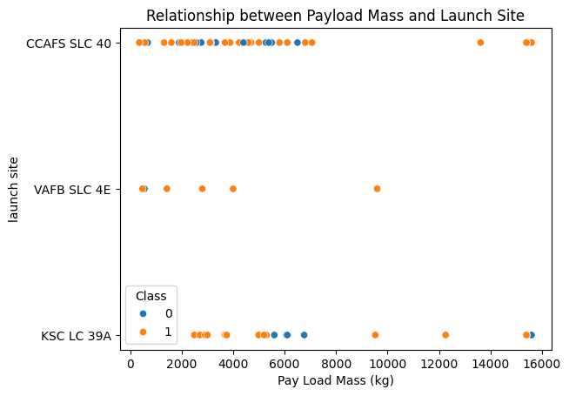
Payload vs. Launch Site
It is observed that in the Payload Mass vs. Launch Site scatter plot, there are no rockets launched with a heavy payload mass (greater than 10,000) from the VAFB-SLC launch site.

Slide 20
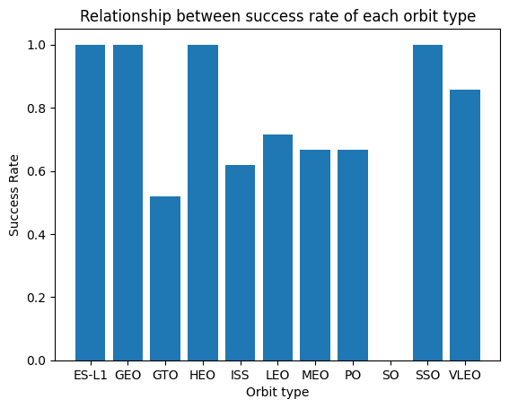
Success Rate vs. Orbit Type
From this bar chart, it is evident that the ES_L1, GEO, HEO, and SSO orbits collectively have the highest success rates.

Slide 21
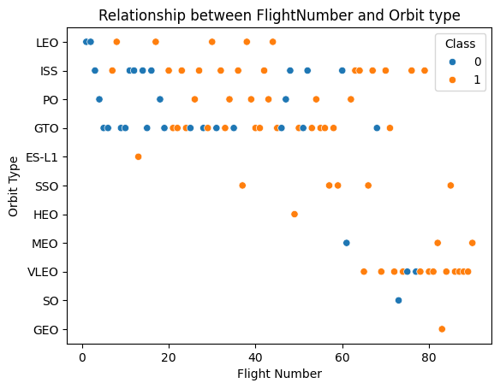
Flight Number vs. Orbit Type
It is observed that in the LEO orbit, success seems to be related to the number of flights. Conversely, in the GTO orbit, there appears to be no relationship between flight number and success.

Slide 22
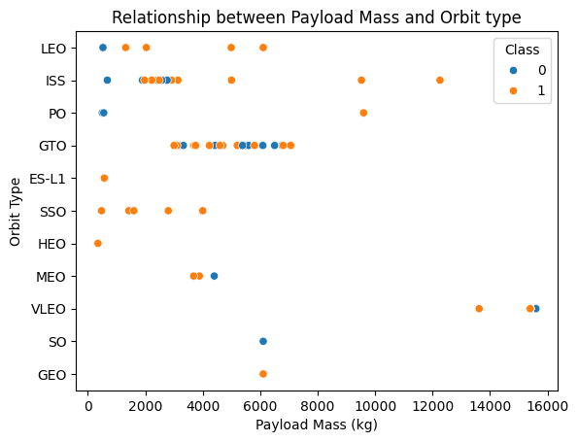
Payload vs. Orbit Type
With heavy payloads the successful landing or positive landing rate are more for Polar, LEO and ISS.
However, for GTO, it's difficult to distinguish between successful and unsuccessful landings as both outcomes are present.

Slide 23
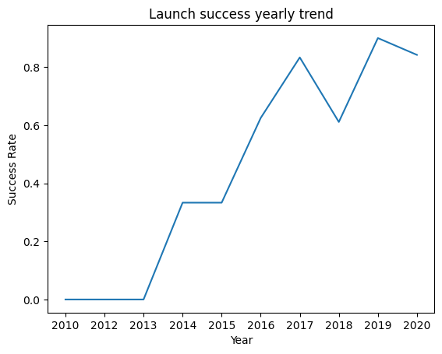
Launch Success Yearly Trend
It is observed that the success rate since 2013 kept increasing till 2020.

Slide 24
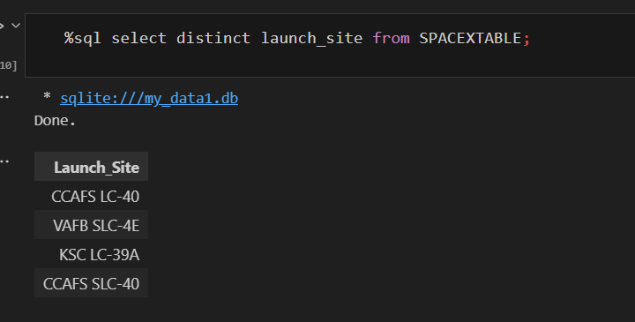
All Launch Site Names
Used ‘SELECT DISTINCT’ statement to return only the unique launch sites from the ‘LAUNCH_SITE’ column of the SPACEXTBL table

Slide 25
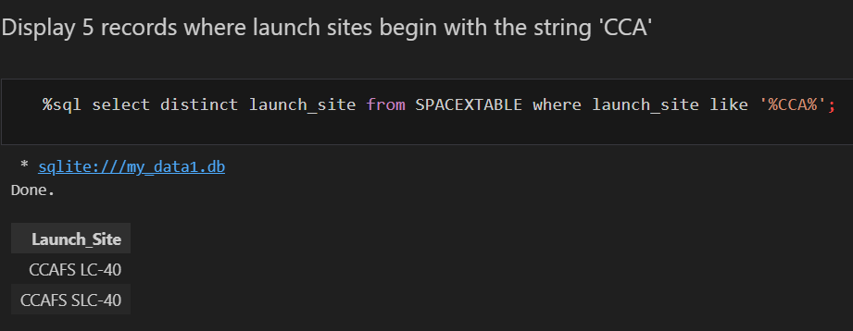
Launch Site Names Begin with 'CCA'
Used ‘LIKE’ command with ‘%’ wildcard in ‘WHERE’ clause to select and display a table of all records where launch sites have the string ‘CCA’

Slide 26
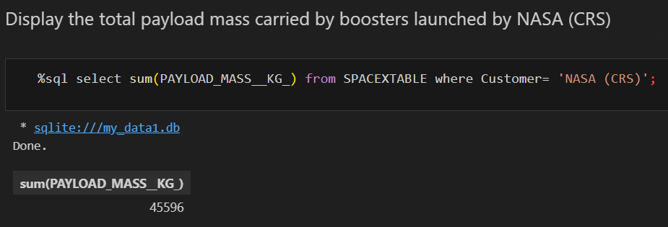
Total Payload Mass
Used the ‘SUM()’ function to return and display the total sum of ‘PAYLOAD_MASS__KG_’ column for Customer ‘NASA (CRS)’

Slide 27
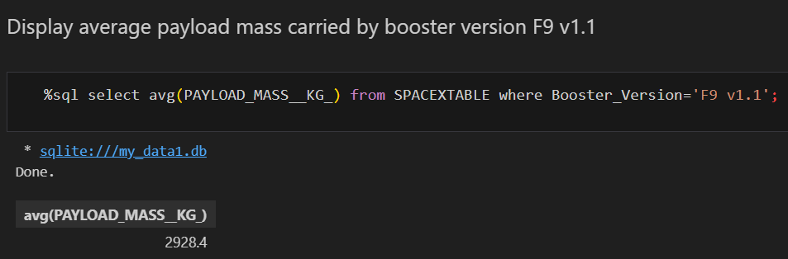
Average Payload Mass by F9 v1.1
Used the ‘AVG()’ function to return and display the average payload mass carried by booster version F9 v1.1

Slide 28
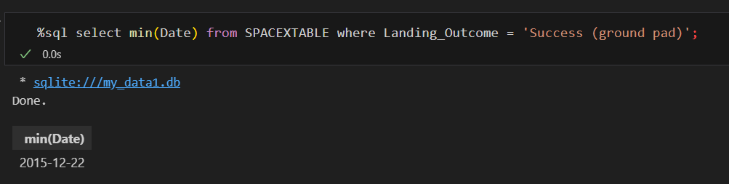
First Successful Ground Landing Date
Used the ‘MIN()’ function to return and display the first (oldest) date when first successful landing outcome on ground pad ‘Success (ground pad)’ happened.

Slide 29
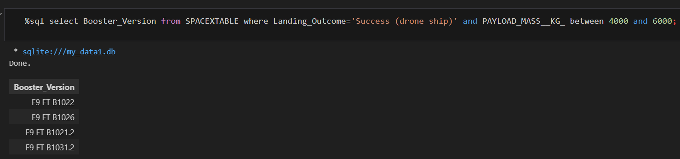
Successful Drone Ship Landing with Payload between 4000 and 6000
Used ‘Select’ statement to return and list the names of boosters with payloads between 4000-6000 and landing outcome of ‘Success (drone ship)’.

Slide 30
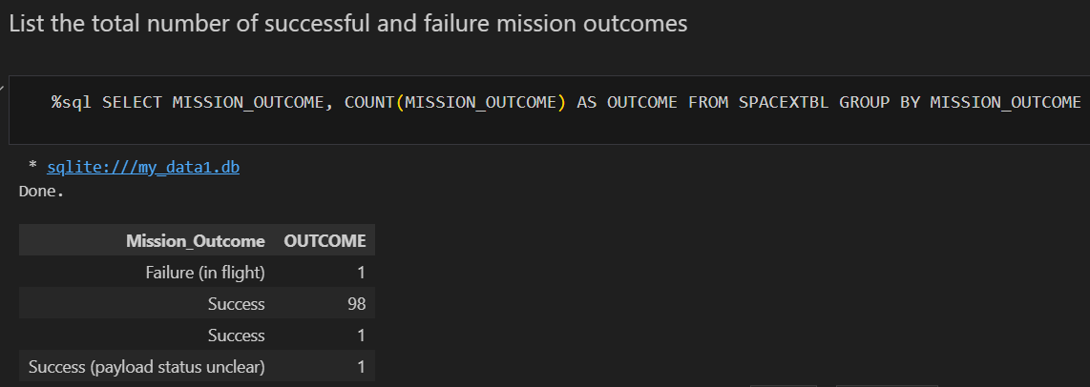
Total Number of Successful and Failure Mission Outcomes
Used the ‘COUNT()’ together with the ‘GROUP BY’ statement to return total number of missions outcomes

Slide 31
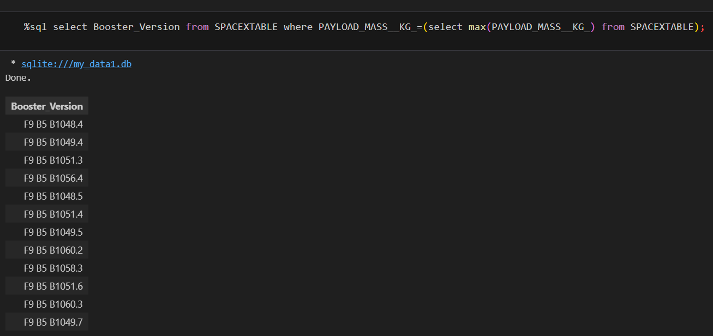
Boosters Carried Maximum Payload
Using a Subquery to return and pass the Max payload and used it list all the boosters that have carried the Max payload of 15600kgs

Slide 32
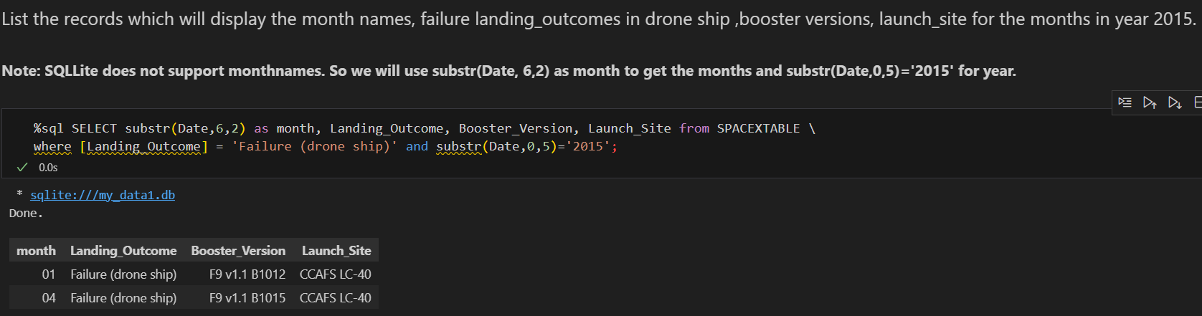
2015 Launch Records
Used the ‘substr()’ in the select statement to get the month and year from the date column where substr(Date,0,5)='2015' for year and Landing_outcome was ‘Failure (drone ship)’ and return the records matching the filter.

Slide 33
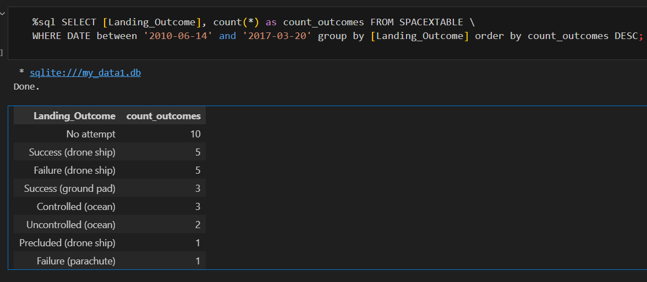
Rank Landing Outcomes Between 2010-06-04 and 2017-03-20
Used ‘COUNT’, ‘ORDER’ and ‘WHERE’ and ‘and’ clause to filter out the landing outcomes between ‘2010-06-14’ and ‘2017-03-20’ in descending order and rank them accordingly.

Slide 34

Section 3

Slide 35
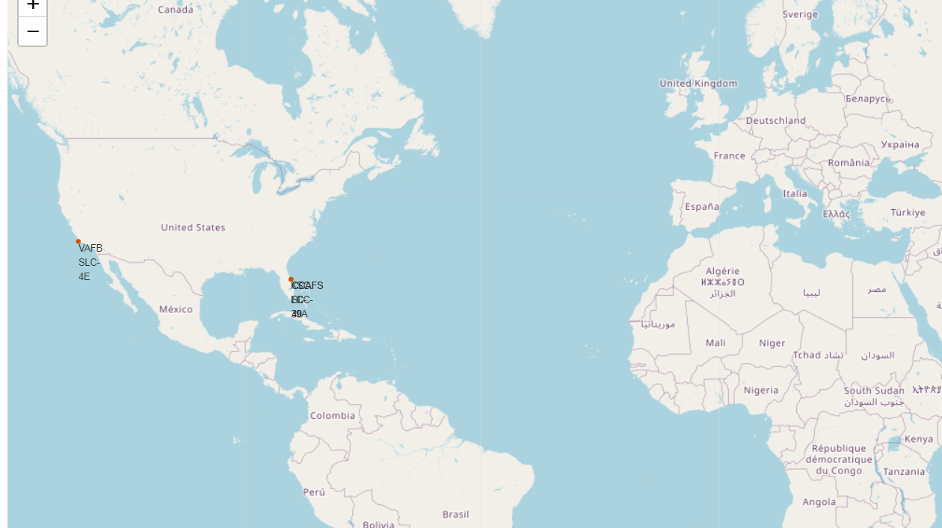
Markers of all launch sites on global map
All launch sites are located near the Equator, to the south of the US, and are situated very close to the coast.

Slide 36
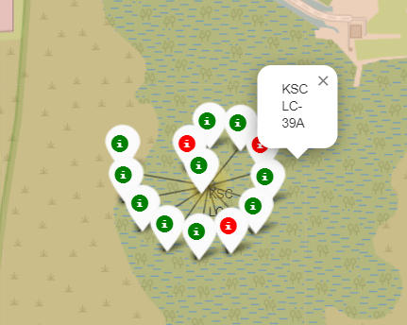
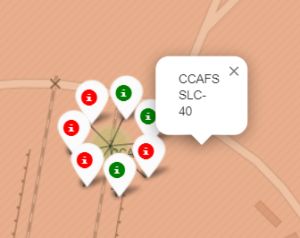
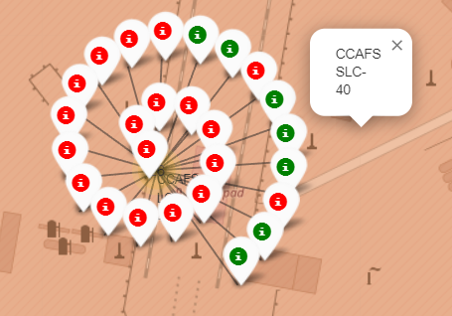
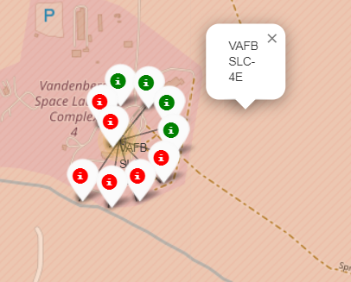
Launch outcomes for each site on the map With Color Markers
In the Eastern coast (Florida) Launch site KSC LC-39A has relatively high success rates compared to CCAFS SLC-40 & CCAFS LC-40
(Green marks for successful launches and red for unsuccessful launches)

Slide 37
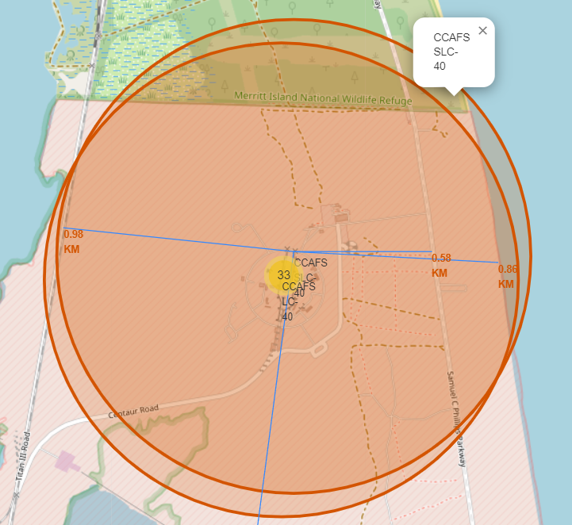
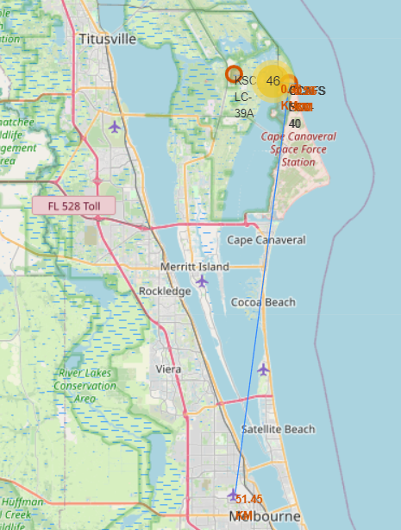
Distances between CCAFS SLC-40 launch site to its proximities
Railways and Highways are in close to minimize logistic cost.
Launch Sites are far from cities and close to coastline because crew has option to abort launch and attempt water landing, also to minimize people and property at risk from falling debris

Slide 38

Section 4

Slide 39
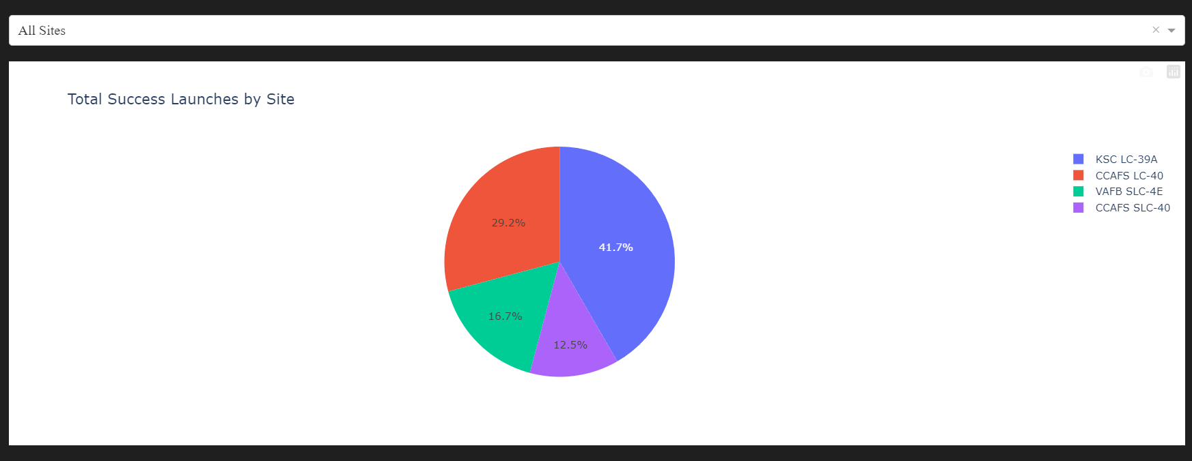
Pie-Chart for launch success count for all sites
Launch site KSC LC-39A has the highest launch success rate at 41.7% while CCAFS SLC-40 has lowest success rate of 13%

Slide 40
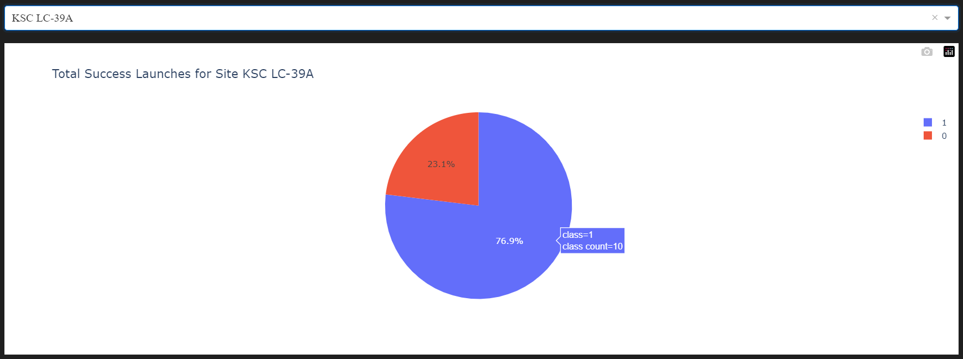
Pie chart for the launch site with highest launch success ratio
It is observed that launch site KSC LC_39A have highest launch success ratio of nearly 3:4

Slide 41
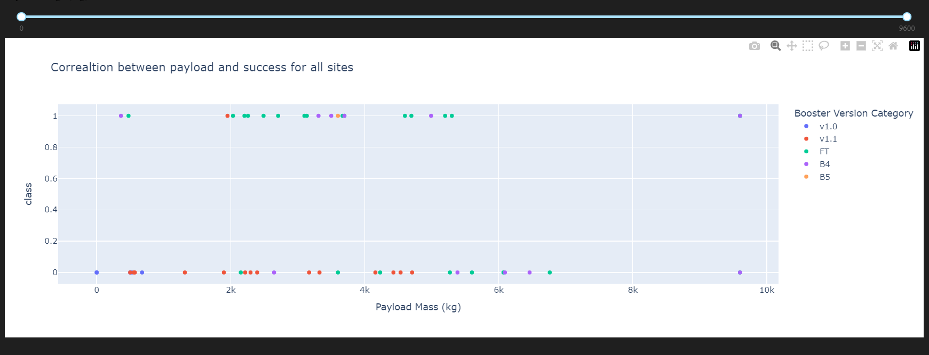
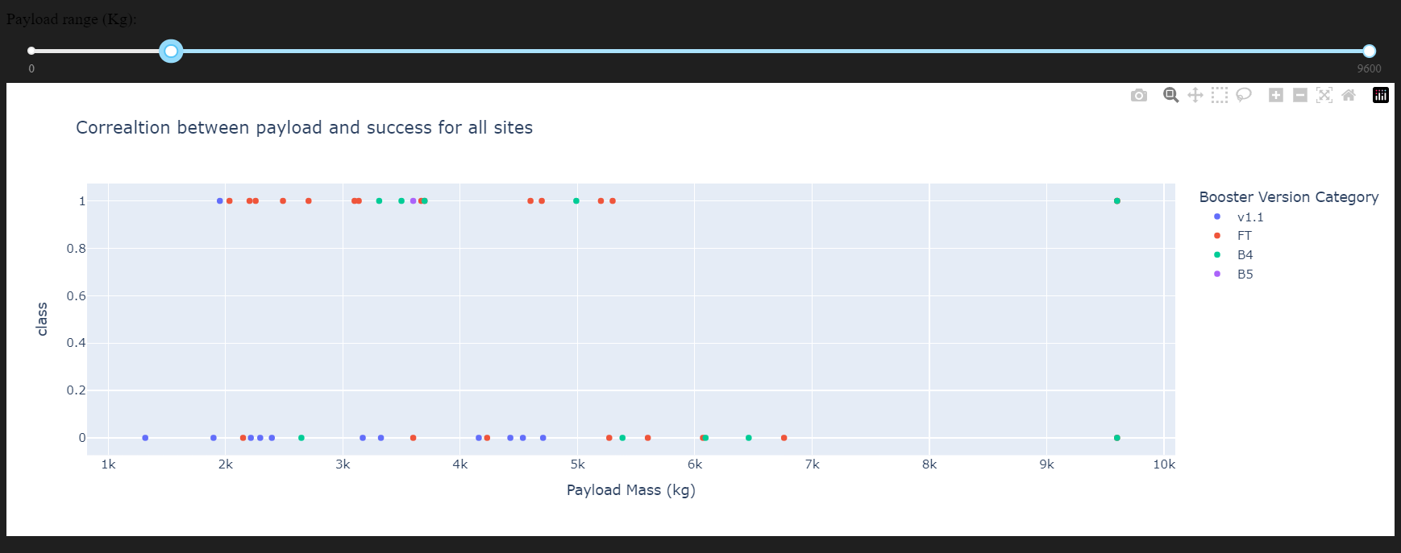
Payload vs. Launch Outcome scatter plot for all sites

Slide 42
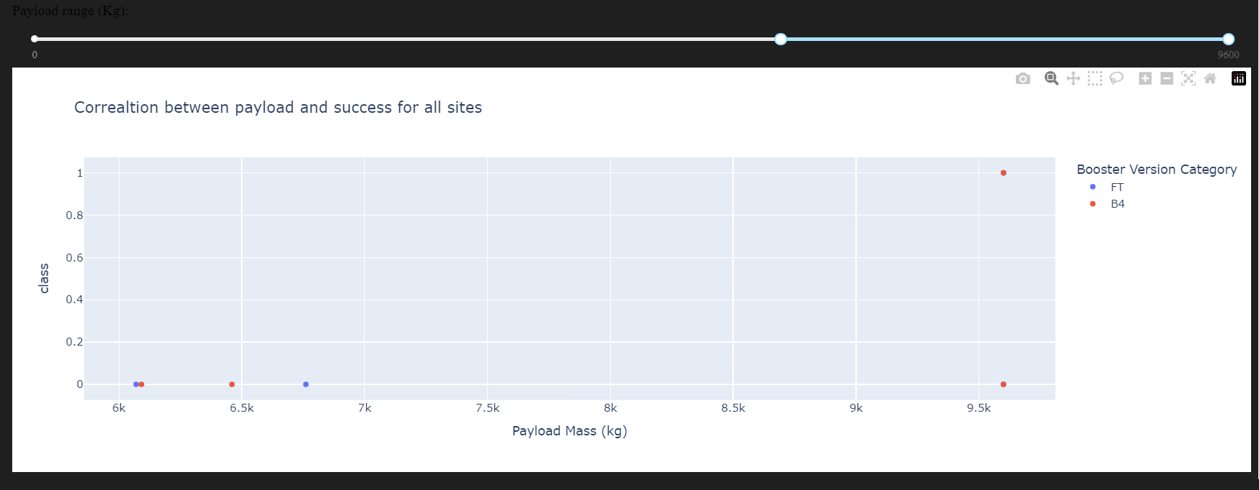
Payload vs. Launch Outcome scatter plot for all sites(Cont…)
Payload between 1900 and 5300 (kg) and highest success rate while payload between 6000 and 9500(kg) have lowest success rate as evident in the figures.
FT Booster version has the highest launch success rate.

Slide 43

Section 5

Slide 44
Classification Accuracy
All the methods perform equally on the test data: i.e. They all have the same accuracy of 83.33% on the test Data

Slide 45
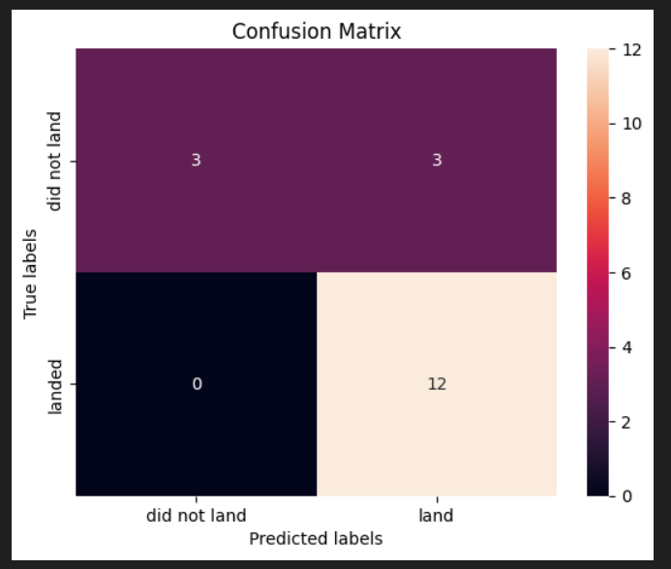
Confusion Matrix
As all the models have same accuracy, therefore they have same confusion matrix too.
Examining the confusion matrix, we see that models can distinguish between the different classes. We see that the problem is false positives.
True Positive - 12 (True label is landed, Predicted label is also landed)
False Positive - 3 (True label is not landed, Predicted label is landed)
Precision = TP / (TP + FP) = 12 / 15 = 0.8
Recall = TP / (TP + FN) = 12 / 12 = 1
F1 Score = 2 * (Precision * Recall) / (Precision + Recall)
= 2 * (0.8 * 1) / (0.8 + 1) = 0.89
Accuracy = (TP + TN) / (TP + TN + FP + FN) = 0.833

Slide 46
Conclusions
Overall all model performance similar on the test set.
Most launch sites are located near the equator to take advantage of the Earth's rotational speed, reducing fuel and booster costs.
All launch sites are situated close to the coast, railways and highways to reduce logistics cost.
The success rate of launches has increased over time.
KSC LC-39A launch site has the highest success rate among launch sites, achieving a 100% success rate for launches with payloads less than 5,500 kg.
Across all launch sites, a higher payload mass (kg) is associated with a higher success rate.
Orbits such as ES-L1, GEO, HEO, and SSO have a 100% success rate.
AS future possibility expanding the dataset may enhance the predictive analytics results and determine whether the findings can be generalized to a broader dataset. These results can help Space Y to better estimate the costs of launches and make informed decisions to compete effectively with SpaceX.

Slide 47
Appendix
To request rocket launch data from SpaceX API following URL was used : https://api.spacexdata.com/v4/launches/past
To make the requested JSON results more consistent, following static response object was used: https://cf-courses-data.s3.us.cloud-object-storage.appdomain.cloud/IBM-DS0321EN-SkillsNetwork/datasets/API_call_spacex_api.json
The Wikipedia site used for web scraping SPACEX data is: https://en.wikipedia.org/w/index.php?title=List_of_Falcon_9_and_Falcon_Heavy_launches&oldid=1027686922
The dataset used for marking all launch sites on map in folium: https://en.wikipedia.org/w/index.php?title=List_of_Falcon_9_and_Falcon_Heavy_launches&oldid=1027686922

Slide 48
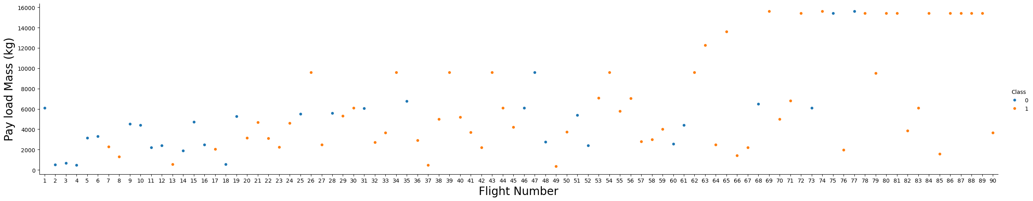
Appendix (Cont…)
The following scatter plot was created to study the relation between flight number payload mass and launch success –
This plot suggests that as the flight number increases, the likelihood of the first stage landing successfully also rises. Additionally, payload mass seems to play a role; even with heavier payloads, the first stage frequently returns successfully

Slide 49
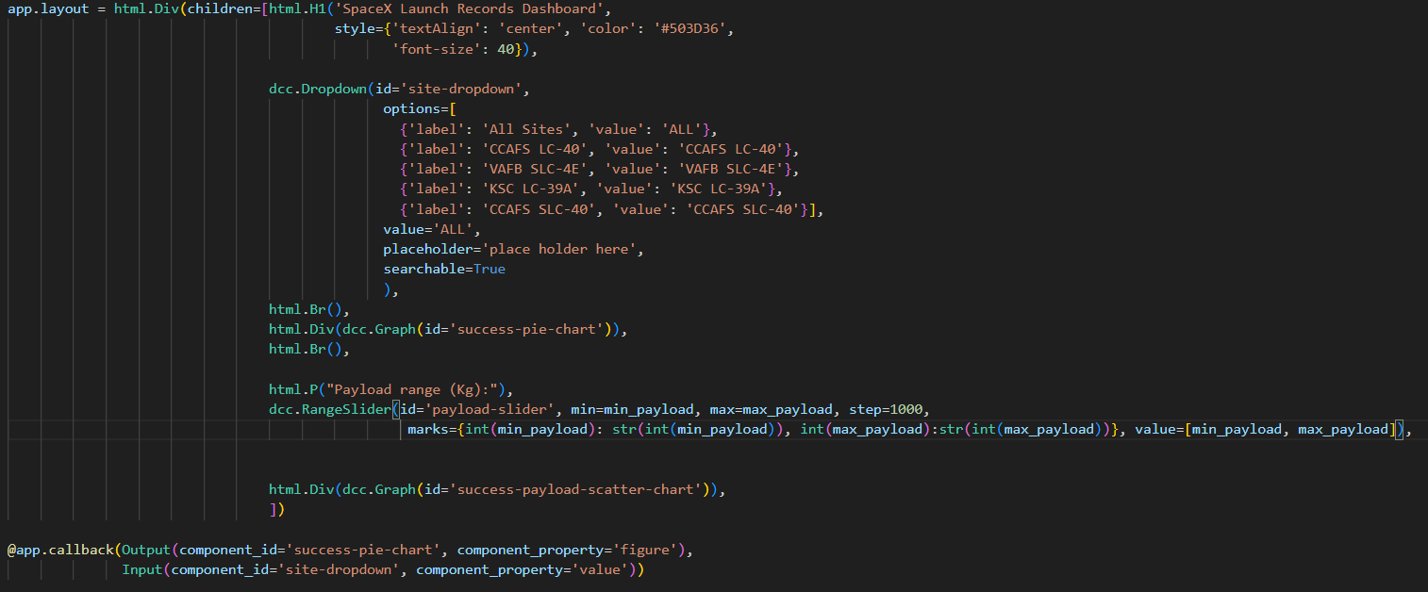
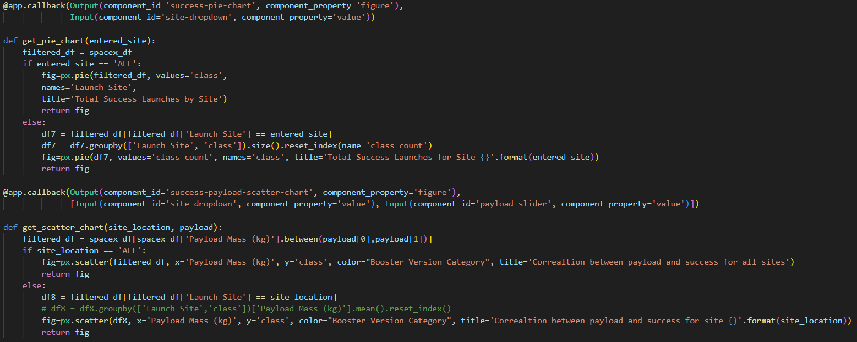
Appendix (Cont…)
The python code snippet for creating the app layout-
The python code to add the callback functions-

Slide 50


